Slide 1
Automata and Regular Languages Lecture 2
John P. Baugh, Ph.D. University of Michigan - Dearborn

Slide 2
Introduction
Previously, we discussed how models help us to simplify and describe more complicated constructs
In this lecture, we begin looking at ways of modeling formal languages
This helps us discuss languages in general
As a related exercise, we will learn how to model languages with simple abstract computers (automata)
This will help us to lay a strong foundation to understand compilers, computers, digital computing, and other aspects of computer science

Slide 3
Lecture 2 Contents
Formal Language Prerequisites
Methods for Modeling Languages
Recursive Definitions and Regular Languages
Finite Automata (FA)
Transition Graphs (TG)

Slide 4
Formal Language Prerequisites
Fundamental constructs

Slide 5
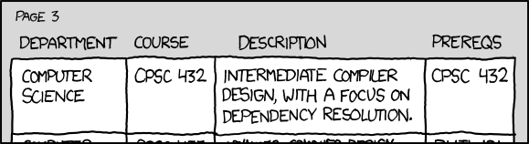

© XKCD
Hopefully, you remember Set Theory from CIS 275
A set is typically viewed as a collection of elements
Sets are usually designated as uppercase letters, such as “the set S”
Sets cannot have duplicates
Multisets, or “Bags” can
Recall that a union of two sets, S and T, denoted S $⋃$ T, is the set of all elements from both S and T
E.g., if S = {a, b, c, d} and T = {d, e, f, g}, then S ⋃ T = {a, b, c, d, e, f, g}
Notice that the “d”, while in both sets, is not duplicated

Slide 6
Alphabets
In formal language theory, an alphabet (typically designated by the Greek letter sigma, Σ)
is a set
The elements of the alphabet are letters (symbols)
For example, the following are different alphabets:
Σ = {a, b} ← alphabet of only the letters a and b
Σ = {0, 1} ← binary number alphabet
Σ = {x, y, z} ← alphabet of the letters x, y, z

Slide 7
Strings and Words
A string or word is a collection of letters from an alphabet, concatenated together
For example, the following are strings from the alphabet Σ = {a, b}
abbaa
abaab
bbb
aaa
An empty string, denoted by the Greek letter lambda, λ , is a string with no letters, and which takes no space
Generally, the empty string is not considered part of any alphabet
abλba = abba
In fact, putting any empty string anywhere in the above string doesn’t change it, as implicitly, there is an empty string between each letter in the string, that is: aλbλbλa

Slide 8
Strings and Words
As a shortcut, we use the exponential notation to indicate multiples of letters in a string
E.g.,
a²b³ = aabbb
ba²b²a = baabba
We say that the letters are concatenated

Slide 9
Cardinality
The cardinality of a string (also, word) w, denoted |w| is the number of letters in the string
The cardinality is also called the length or the size of the string
For example:
w₁ = abbab, so |w₁| = 5
w₂ = b²a³b⁴a, so |w₂| = 10

Slide 10
Reverse of a String
The reverse of a string w is a string with the letters in reverse order
w₁ = abbb, so reverse(w₁) = bbba
w₂ = baaba, so reverse(w₂) = abaab
A string w of which the reverse(w) = w is a palindrome
w₃ = abba, reverse(w₃) = abba ← same, so this is a palindrome

Slide 11
Languages
A language (typically denoted L) over an alphabet Σ is a set of strings on that alphabet
Example: Given an alphabet Σ = {a, b}, the following are languages over Σ:
L₁ = { a, ab, ab², … }
L₂ = { a^{m}b^{n} : m > 0, n > 0 }
L₃ = { a^{m}b^{m} : m > 0 }
L₄ = { b^{m}ab^{n} : m ≥ 0, n ≥ 0 }
Descriptions of the above languages over the alphabet Σ are as follows:
L₁ is the language consisting of all words starting with an a and followed by 0 or more b’s
L₂ is the language consisting of all words beginning with one ore more a’s, followed by one or more b’s
L₃ is the language consisting of all words beginning with one or more a’s, followed by the same number of b’s
L₄ is the language consisting of all words with exactly one a

Slide 12
Languages : Concatenation
Consider L and M, being languages over an alphabet Σ
The concatenation of L and M, denoted LM is as follows:
LM = { uv : u ∈ L, v ∈ M }
Recall that : means “such that”
and ∈ means “is an element of”
In other words, LM denotes the set of all words which come from concatenating a word from L with a word from M
For example:
L₁ = {a, b²} L₂ = {a², ab, b³} L₃ = {a², a⁴, a⁶, …}
Then,
L₁L₁ = {a², ab², b²a, b⁴}
L₁L₂ = {a³, a²b, ab³, b²a², b²ab, b⁵}
L₁L₃ = {a³, a⁵, a⁷, …, b²a², b²a⁴, b²a⁶, … }

Slide 13
Languages : Powers
The powers of a language L are defined as follows, using the concatenation operations from earlier:
L⁰ = { λ } ← The language isn’t empty, it contains one element, i.e., the empty string
L¹ = { L }
L² = { LL}
L³ = {L²L}
L^{m+1} = L^{m}L

Slide 14

Kleene Closure (Kleene Star)
The Kleene star, or Kleene closure of a set of strings, S:
Is denoted S*
Is the union of all finite concatenations, including 0 concatenations, of the elements of S
If the set is an alphabet, Σ , then Σ* denotes the set of all words on Σ
Thus, from our previous definition of language, a language L on an alphabet Σ is simply a subset of Σ*, that is L $⊆$ Σ*
Kleene is pronounced either “Klay-nee” (as Kleene himself pronounced it), or “Klee-nee”, which is the more widely accepted pronunciation
Using the power notation discussed earlier, the Kleene closure of L is defined by the infinite union:
$$L^{∗}=L^{0} ∪L^{1} ∪L^{2}∪ …= \bigcup_{k=0}^{∞}{L^{k}}$$

Slide 15
Kleene Closure (Kleene Star)
Examples
S = { x }, then S* = { λ, x, xx, xxx, … } = { λ, x, x², x³, … }
S = {a, b, c}, then S* = { λ, a, b, c, aa, ab, ac, ba, bb, bc, ca, cb, cc, aaa, aab, aac, … }
S = {1, 01}, then S* = { λ, 1, 01, 11, 111, 101, 011, …}
Note that here, 01 is treated as a single string of the set

Slide 16
Bonus: Kleene Plus
The Kleene Plus of a set of strings, S, is denoted S⁺ and is the same as S*, but excludes the empty (null) string, λ

Slide 17
Methods for modeling languages
Different ways of modeling in order to understand languages

Slide 18
Methods of Modeling Languages
As we well know, there are different ways to model various constructs
E.g., to model an equation: you can write it out, give a table of values, or graph the equation
In formal language theory, we have four primary ways we use to model languages
By describing them (Description)
By recursive definition (Recursion)
By using regular expressions
By using finite automata

Slide 19
Modeling by Description
We have largely modeled languages thus far using descriptions
You list examples, or give rules related to the language
E.g. given an alphabet, Σ = {a, b}
L₁ = {a, ab, abb, abbb, …} ← described as a language on {a, b} that has one a, followed by 0 or more b’s
L₂ = { even number of a’s, followed by any number of b’s, including 0 }
Etc.

Slide 20
Recursive Definitions
A recursive definition is another way to model a language
Very useful for infinite languages
Closely resemble an induction proof
Recursive definitions of formal languages consist of 3 parts
Base case – finite list of strings in the language
Recursive step – rule or set of rules for generating new strings in the language using other strings
“Nothing else” statement – a statement that nothing else is in the language except for that which is in (1) and (2) above

Slide 21
Recursive Definition: Example 1
The following is a definition of the language PEI (positive, even, integers)
PEI = {2, 4, 6, 8, …}
Recursive definition:
Base case: 2 ∈ PEI
Recursive step: If x ∈ PEI, so is x + 2
Nothing else : nothing not described in (1) or (2) is in PEI

Slide 22
Recursive Definitions: Example 2
Consider a language, INT, the language containing all integers
INT = { …, -3, -2, -1, 0, 1, 2, 3, … }
Recursive definition
Base case: 0 is in INT
Recursive step: If x is in INT, then x-1 and x-2 are in INT
Nothing else: Nothing but the generated strings (words) above in (1) and (2) are in INT

Slide 23
Recursive Definitions: Example 3
Consider a language HALF over {a, b} where the number of a’s is half the number of b’s
Description:
HALF = { a^{n}b^{2n} : n ≥ 0 }
= {λ, abb, aabbbb, aaabbbbbb, … } = {λ, ab², a²b⁴, a³b⁶, … }
Recursive definition:
λ is in HALF
If x is in HALF, then so is axbb
Nothing else is in HALF

Slide 24
Recursive Definitions: Exercise 1
Given the alphabet Σ = {a, b}:
The language L = All strings over Σ where the number of a’s is equal to the number of b’s = {λ, ab, ba, abba, baab, baba, abab, aabb, bbabaa, … }
Exercise: Give the recursive definition of the above

Slide 25
Recursive Definitions: E1 Solution
Given the alphabet Σ = {a, b}:
The language L = All strings over Σ where the number of a’s is equal to the number of b’s = {λ, ab, ba, abba, baab, baba, abab, aabb, bbabaa, … }
Recursive definition:
λ is in L
If x is in L, axb, bxa, xab, xba, abx, and bax are in L
Nothing else is in L

Slide 26
Regular Expressions and Languages
A regular expression is a special type of recursive definition
Base Case: λ and any element of Σ is a regular expression
Recursive Step: If r₁ and r₂ are regular expressions, then so are:
(r₁)
r₁r₂
r₁ + r₂ ← + is the OR operator
r₁*
Nothing else: Nothing except that which is in (1) and (2) is a regular expression
Any language that can be described by a regular expression is a regular language

Slide 27
Regular Expressions
Another useful definition (functionally equivalent to the earlier definition) is as follows:
Each of the following is a regular expression over an alphabet Σ:
The symbol λ (empty string) and the pair “( )” (empty expression) are regular expressions
Each letter (symbol) in Σ is a regular expression
If r is a regular expression, then (r*) is a regular expression
Kleene star can be performed on a set of strings, OR symbols
If r₁ and r₂ are regular expressions, then (r₁ + r₂) is a regular expression
+ indicates “OR” in this context
If r₁ and r₂ are regular expressions, then (r₁r₂) is a regular expression
All other regular expressions are formed using the above rules, and that all regular expressions are special strings (words) that use the letters of Σ and the five symbols:
( ) * + λ

Slide 28
Regular Expressions
Again, the + sign indicates the OR operation
So, if the expression is s₁ + s₂, this means use s₁ or s₂
Example:
abba + ab + bb describes the set {abba, ab, bb}
Example:
(a + b)(a + b) = {aa, ab, ba, bb}
since we choose a or b from the first (a + b), and then a or b from the second

Slide 29
Regular Expressions: Exercise Set 1
It’s important to know how to
Describe a regular expression in English
Come up with a regular expression, given an English description
Try to do the following:
Ex. 1: What does the regular expression (a + b)* mean?
Ex. 2: What does the regular expression ( (a + b)(a + b) )* mean?
Ex. 3: Give the regular expression for all strings on {a, b} of at least length 1
Ex. 4: Give the regular expression for all strings where b is the second letter

Slide 30
Regular Expressions: Exercise Set 1
It’s important to know how to
Describe a regular expression in English
Come up with a regular expression, given an English description
Ex. 1: What does the regular expression (a + b)* mean?
All strings with any number of a’s and b’s in them, including 0 or either, yielding λ, the empty string
Ex. 2: What does the regular expression ( (a + b)(a + b) )* mean?
All strings with even length
Ex. 3: Give the regular expression for all strings on {a, b} of at least length 1
(a + b)(a + b)*
Ex. 4: Give the regular expression for all strings where b is the second letter
(a + b)b(a+b)*

Slide 31
Regular Expressions: Exercise Set 2
Consider the language L, defined over the alphabet Σ = {a, b}
Ex. 1: Give a regular expression to generate words having at least one a
Ex. 2: Give a regular expression to generate words having at least one a, followed by at least one b
Ex. 3: Give a regular expression to generate words not containing aa

Slide 32
Regular Expressions: Exercise Set 2
Consider the language L, defined over the alphabet Σ = {a, b}
Ex. 1: Give a regular expression to generate words having at least one a
(a+b)*a(a+b)*
Ex. 2: Give a regular expression to generate words having at least one a, followed by at least one b
(a+b)*a(a+b)*b
Ex. 3: Give a regular expression to generate words not containing aa
λ + a + b + (ab + bb + ba)*
Also, the same:
λ + a + b + (b + ab)* + (b + ba)*

Slide 33
Finite Automata
Abstract machines representing language

Slide 34
Finite Automata
Another way to model languages is through the use of finite automata, which can be viewed as machines constructed for each language
Plural: finite automata
Singular: finite automaton
A finite automaton takes a string as input, and gives output of “yes” or “no”, indicating whether the input string is part of the language

Slide 35
Finite Automata (Definition 1)
Definition 1: A finite automaton consists of three things:
A finite number of states (denoted σ), one of which is denoted the start state (typically σ₀), and some (or none) of which are designated as the final or accept state(s.)
A finite alphabet (denoted Σ) of possible input letters (symbols.)
We will typically use Σ= {a, b} for the sake of simplicity
A finite set of rules or transitions, T, that uniquely map every state and every letter into another state, in other words, T : σ × Σ → σ
This is the primary definition used in the course pack by B.S. Elenbogen & J.P. Baugh

Slide 36
Finite Automata (Definition 2)
A slightly more verbose definition is extremely useful
A finite automaton A consists of the following:
A finite set I of input symbols
A finite set O of output symbols
A finite set S of states
A next-state function f from S × I into S
An output function g from S × I into O
An initial state, σ₀
So, we can say that A = (I, O, S, f, g, σ₀)
That is, a finite automaton consists and requires all of those things mentioned above
This is the definition used by R. Johnsonbaugh

Slide 37
Finite Automata: Table
One way of defining a finite automaton (FA) is using a table
The following is a type of question you might be asked on a quiz or test
Example: Let I = {a, b}, O = {0, 1}, S = {σ₀, σ₁} //assume 0 is NO, 1 is YES
Define the pair of functions f: S × I → S and g: S × I → O by the rules given in the following table
Remember: f defines “what state do I go to next”, and g defines what the output is
 |  | f |  | g
 | I (input): | a | b | a | b
S
σ₀ |  | σ₀ | σ₁ | 0 | 1
σ₁ |  | σ₁ | σ₁ | 1 | 0

Slide 38
Finite Automata: Table
Given the table, we can find the next-state function f, and the output function g
f(σ₀, a) = σ₀ g(σ₀, a) = 0
f(σ₀, b) = σ₁ g(σ₀, b) = 1
f(σ₁, a) = σ₁ g(σ₁, a) = 1
f(σ₁, b) = σ₁ g(σ₁, b) = 1
 |  | f |  | g
 | I (input): | a | b | a | b
S
σ₀ |  | σ₀ | σ₁ | 0 | 1
σ₁ |  | σ₁ | σ₁ | 1 | 1

Slide 39
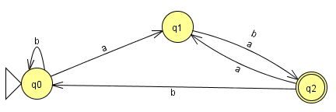
Finite Automata: Transition Diagrams
Another very popular way of defining FA is with transition diagrams
The initial state is indicated with the triangle
The final (accept) state is indicated with a double circle
This (and other) diagrams are created using JFLAP (jflap.org)

Slide 40
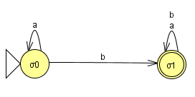
Finite Automata: Transition Diagrams
 |  | f |  | g
 | I (input): | a | b | a | b
S
σ₀ |  | σ₀ | σ₁ | 0 | 1
σ₁ |  | σ₁ | σ₁ | 1 | 1
Using our table from earlier, we can construct a finite automaton for the language
The initial state is indicated with the triangle
The final (accept) state is indicated with a double circle
This (and other) diagrams are created using JFLAP (jflap.org)

Slide 41
Acceptance
A word or string is accepted if the finite automaton is in an accepting state at the end of the word.
The word is rejected otherwise.
Note there must be 2 arrows leaving each state, one for a and one for b.
Note that there can be more than 1 accept state but only 1 start state.

Slide 42
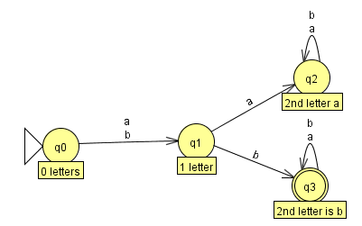
Finite Automata: Example 1
Assuming the alphabet Σ = {a, b}, define a FA for a language L = { second letter is b }
We can use techniques from before, or a FA to describe this language
We are tasked of course, with ultimately finding the FA for this language, so we can dive right in
The first letter doesn’t matter (a or b is fine)
The second letter does matter
If it’s an a, we are never going to accept the string since the language requires second letter be the letter “b”
If it’s a b, we are in the accept state, so no matter what the subsequent letters are, we accept the string
Note: the text notes below the states are for clarification and are not part of the FA

Slide 43
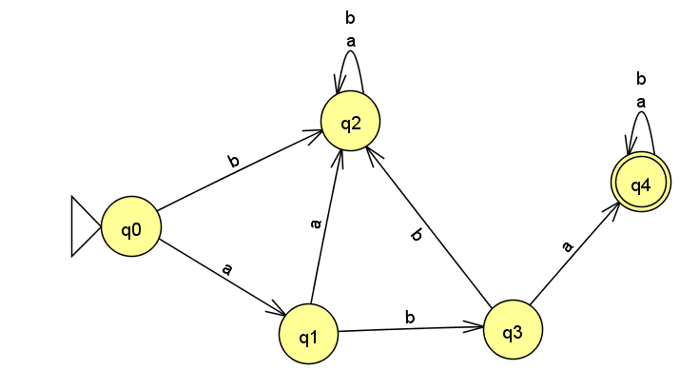
Finite Automata: Example 2
Build a FA over Σ = {a, b}, L = { starts with substring aba}
Examples: {aba, abaa, abab, ababb, …}
Notice that q2 is a dead end / fail state
q1 and q3 are used as intermediary states on the way to acceptance state of q4

Slide 44
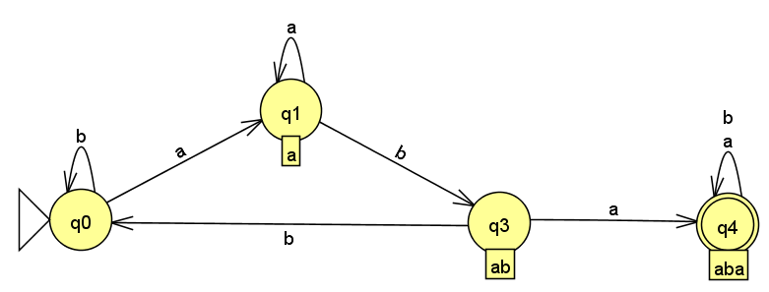
Finite Automata: Example 3
Build a FA over {a, b}, L = { contains the substring aba}
This one is a little more complex
The aba can occur anywhere in the string
If we start with b, we cycle in q0
We only “move toward” acceptance when the initial a is encountered, moving us to q1
From q1, more a’s keep us in this state
From q1, if b is encountered, we’re closer to our goal (we’re at ab) → q3
Now, if b is encountered while in q3, we must start over (go back to q0)
But, if we’re in q3 and an a is encountered, we’ve met our goal
Subsequent letters while in q4 don’t matter

Slide 45
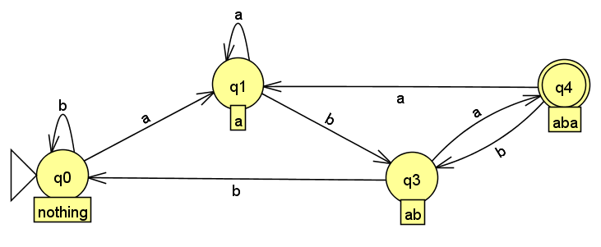
Finite Automata: Example 4
Build a FA over {a, b} to represent the language L = {ends with aba}
Even more complex
Remember: Each state must consider what happens if any letter is encountered
For each state, we must consider what “brought us here”
E.g., If you’re in q4, an aba got you there… but if you encounter any other letter, we leave the state:
If in q4, and we see another a, we have to go back to q1, because that state is the state we encounter when at least one a in a row is encountered (with no b’s directly in front)
If in q4, and we see the letter b, we must go back to q3, which is okay, because an “a” got us to q4, and with “b” encountered, we have “ab”, so in q3, another a will get us back to q4 (because “aba”)

Slide 46
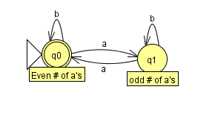
Finite Automata: Example 5
Build a FA over {a, b} for a language L = { strings with even number of a’s }
We assume no a’s = 0 a’s, so 0 is defined as even, so in this case, the initial state q0 is an acceptance state too
Any time we are in q0 and see an a, we move to q1
While in q1, if we see an a, we move back to q0

Slide 47
Transition Graphs (TGs)
A transition graph relaxes the requirements on the FA
Allows multiple start states
Allows words or even the empty string, λ on an edge
Allows 0 or 1 or any number of edges from a state
We now have non-determinism
Therefore, the machine can crash!
We accept a word if there is some path that accepts it
Either ending in a non-accept state, or crashing mean the word isn’t in the language
Sometimes, one path might crash or end in non-accept, but another (from the same word might end in accept)
if this happens, we accept the word since there’s at least one path that accepts it

Slide 48
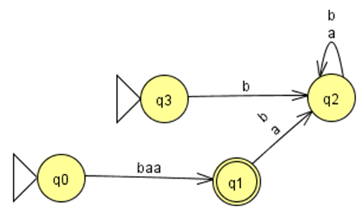
Transition Graphs: Example 1
The language of this TG, L = { baa }
Only accepts the string “baa”
Note there is more than one path for baa
E.g., q3→q2→q2 (non-accept)
E.g., q0→q1 (accept)

Slide 49
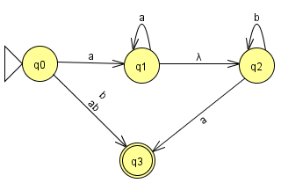
Transition Graphs: Example 2
Are the following accepted by the TG?
λ
a
b
aa
ab
aba
abba
bab

Slide 50
Transition Graphs: Example 2
Are the following accepted by the TG?
λ no
a no
b yes
aa yes
ab yes
aba yes
abba yes
bab no (crashes)

Slide 51
Questions?
Questions?
Comments?
Remarks?

